Slide 1

Sentiment Analysis Using Comments from Social Media
Project Guide: Prof. Deepti Lawand
Vedant Patil
Jayesh Thakur
Kapildev Yadav
DEPARTMENT OF INFORMATION TECHNOLOGY
PILLAI COLLEGE OF ENGINEERING
Academic Year 2018 – 19

Slide 2
Outline
Introduction
Literature Survey
Implementation
3.1 Block Diagram
3.2 Mathematical Model
Input/output Specification
Hardware and Software Details
Application
References
Acknowledgement

Slide 3
Introduction
This project system generally deals with the analysis of comments and tweets from social media, taking it as an input.
Processing them with certain procedure will give the predicted emotion of comment.
Different methods are available for classification and prediction of sentiments from the comments such as rule-based, dictionary based.

Slide 4
Introduction(cont’d.)
Naïve Bayes is the classifier which can be easily used for classification of emotions.
Prediction of Sentiments will be primarily developed on the concept of Plutchik’s wheel of emotions.
It has four pair of sentiments i.e. eight sentiments which has to be displayed as output of analysis of comments.

Slide 5
Literature Survey
Name: | Fine-grained Sentiment Analysis with 32 Dimensions. By Xianchao Wu, Hang Tong, Momo Klyen
Year: | 2017
Description: | This system does deal with range of total 32 emotions. It uses concept of Plutchik’s wheel of emotion to classify comments into different 32 sentiments. The mathematical model of Naïve Bayes is used for classification and prediction uses intensity based technique.
Reference: | IEEE(Institute of Electronic and Electrical Engineering)
Conclusion: | This paper has close resemblance with proposed system. It has vast scope as it classifies the opinions to 32 different sentiments.

Slide 6
Literature Survey (cont’d.)
Name: | Rule-based Emotion Detection on Social Media: Putting Tweets on Plutchik’s Wheel. By Eric Tromp, Mykola Pechenizkiy.
Year: | 15 December 2014
Description: | This paper used RBEM and Plutchik’s wheel of emotion concepts and draws out analysis by putting tweets on Plutchik’s wheel
Reference: | arXiv:1412.468 [cs.CL], Netherlands
Conclusion: | Results of this system shows RBEM-Emo is competitive to current systems supporting three different language
Name: | Combining Strengths, Emotions and Polarities for Boosting Twitter Sentiment Analysis By Felipe Bravo-Marquez, Marcelo Mendoza, Barbara Poblete.
Year: | 2016
Description: | This paper uses Lexicon resources after combining strength and polarity of emotions analysed.
Reference: | University of Chile.
Conclusion: | The technique which is used does boost the performance od Twitter sentiment analysis system.

Slide 7
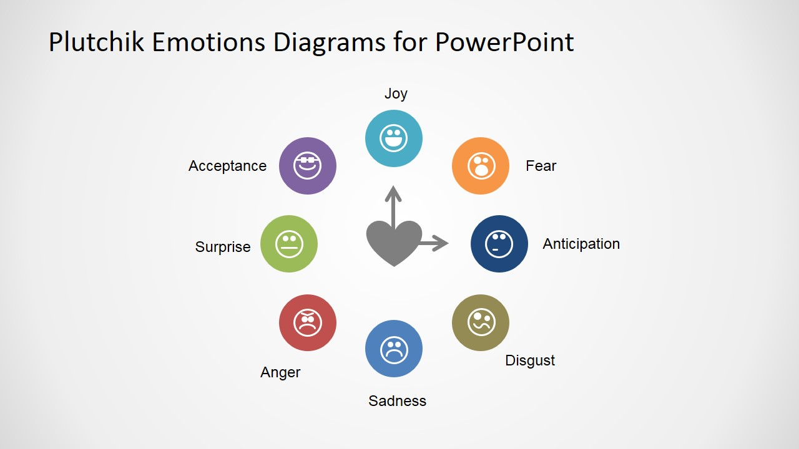
Implementation:

Slide 8
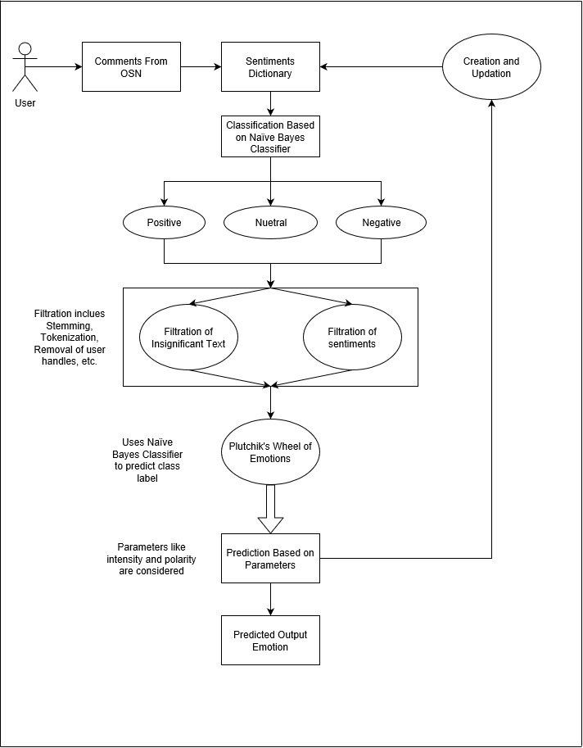
Implementation: Block Diagram

Slide 9
Implementation
Plutchik’s wheel of Emotions:
For tackling problem of emotion detection, we needs notion of emotion. Plutchik’s wheel caters that need. Reason for using this model is that it states that these emotions are culturally independent.
Another reason is model is that each of these emotion are opposite of one of the other basic emotions.
Plutchik’s states that these eight human feelings are derivatives from combination of two basic emotions.

Slide 10
Implementation: Mathematical Model
Naïve Bayes:
Naive Bayes classifier assumes that the presence of a particular feature in a class is not related to the presence of any other feature .
For word W and class C:
P(c/w)=[P(w/c)P(c)]/P(w)
where P(c/w) is probability of class c given word is w. P(c) is probability of class c and P(w) is probability of word w .
Naive Bayes classifier will be
c*=arg maxc P(c/w)

Slide 11
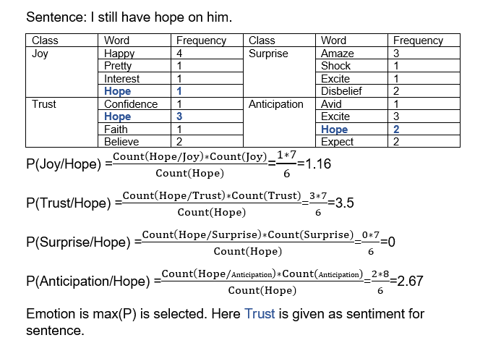
Implementation: Mathematical Model

Slide 12
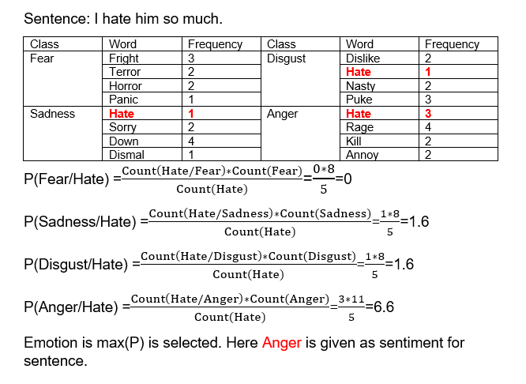
Implementation: Mathematical Model

Slide 13
Implementation Model
Start
Take input of comment
Pre-process and Cleaning Comment.
Classify into Positive, Negative, Neutral.
If comment=“Neutral”
Display result;
Go to Step 14
Else
Display respective result;
Detect Common words.

Slide 14
Implementation Model(cont’d)
Extracting Featured words.
Calculate c*=P(W/C) using Naïve Bayes Classifier formula.
Count P(W/C) for each class of emotion.
Select class where c* is maximum
Save words along with tag of emotion.
Display emotion class.
End

Slide 15
Input and Output Specification
Input Specification:
The user is expected to enter comments on its account which will enable the system to analyse the comments to classify into three sentiments.
The comments should not be blunt sentence as it will not display any sentiment while analysis.
Output Specification:
Output which is given to the user will show the polarity of sentiment on positive and negative side further classifying them on basis of Plutchik’s wheel

Slide 16
Hardware and Software Details
Hardware Details:
Minimum RAM 2 GB required.
Minimum 100 GB internal ROM.
Reliable Internet Connection.
Software Details:
Browser supporting HTML5 and Bootstrap.
Python Compiling Software.
Host Server for website.

Slide 17
Applications
To detect and stop the negative threats solidifying Law and Order.
Sentiments analysis can be effectively used in business for analysing reviews and opinions
It could also be used in different documentation setting. ‘Tone Detector’ is system which is used in Outlook which sets the ‘tone’ of Users mail.

Slide 18
Applications (Contd.)
Text analysis will become easier and will reduce loads from Manual working.
It can be used by organizations in Customer Support and Reputation management.
To forecast market movements based on news, blogs and social media comments.

Slide 19
References
Xianchao Wu, Hang Tong, Momo Klyen, “Fine-grained Sentiment Analysis with 32 Dimensions”, University of Tokyo
Eric Tromp, Mykola Pechenizkiy, “Rule-based Emotion Detection on Social Media: Putting Tweets on Plutchik’s Wheel”, Netherlands
Felipe Bravo-Marquez, Marcelo Mendoza, Barbara Poblete, “Combining Strengths, Emotions and Polarities for Boosting Twitter Sentiment Analysis”, University of Chile
Sci-Hub (http://www.scihub.tw/)
Study.com(http://www.study.com/academy/lessons/Plutchiks-wheel-emotion)
Lexalytics(www.lexalytics.com/Libraries/)

Slide 20
Acknowledgement
We would like to express our specials thanks of gratitude to Principal Dr. Sandeep Joshi and H.O.D Prof. Sharvari Govilkar as well as our Project Guide Prof. Deepti Lawand and Co-Ordinator Prof. Gaytri Hegde who gave us the golden opportunity to do this wonderful project in the topic Sentiment analysis, which also helped us in doing lot of research and we came to know about so many new things.
We are immensely grateful to all of them for sharing their pearls of wisdom with us during this course of research.

